Slide 1
EPIC FMS
A Field Management System (FMS) for the Fall Game
Epic Robotz
Fall 2021
This stack contains useful info about various parts of EpicFMS.

Slide 2

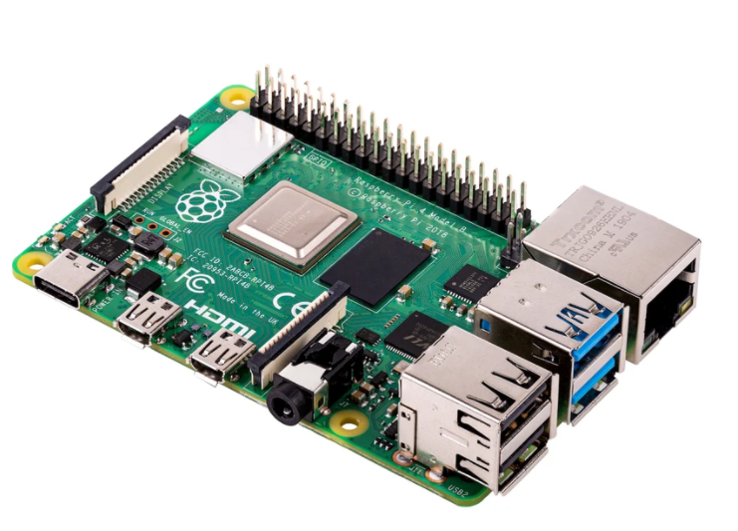



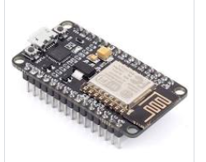
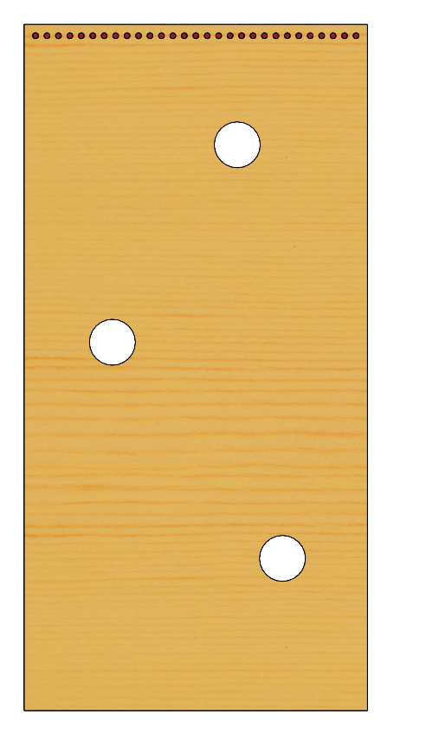
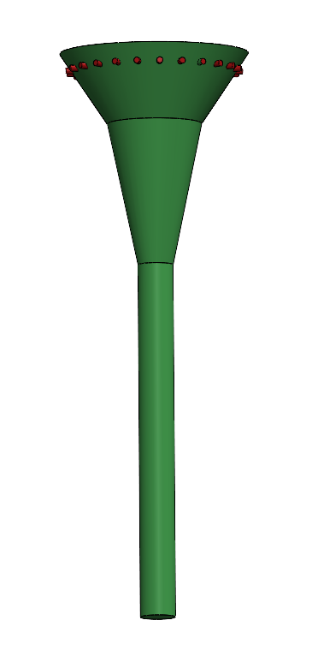
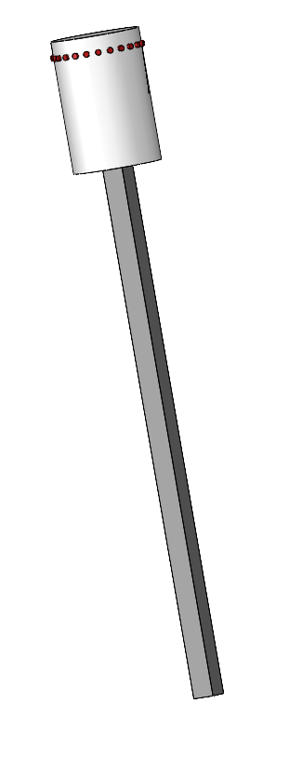
EPIC Robotz FMS System for the Fall 2021 Intramural Game
Epic FMS Internal Wired LAN
From WLAN
To WLAN
EPIC GAME SCORE
(Website)
T
Game Management (Website)
T
Main FMS Server
AP provides strong wifi
Signal for Private wifi
Subnet, SSID=epicfms.
A hole in it’s firewall
Allows web access
To the Main FMS
Server.
Provides Web site for
game Admin, and
Score board across
Wired LAN.
Web Client for Audience Score Board
FMS Administrator
Field Elements:
Each Field Element has a ESP8266 wifi
Module for communication with the
Main FMS Server. The comm is across
a private LAN created by the server.
The server collects hit counts from
each ESP8266 in real time, and sends
commands back to the ESP8266 to
control the NeoPixels, servos, and
motors in the game elements.

Slide 3
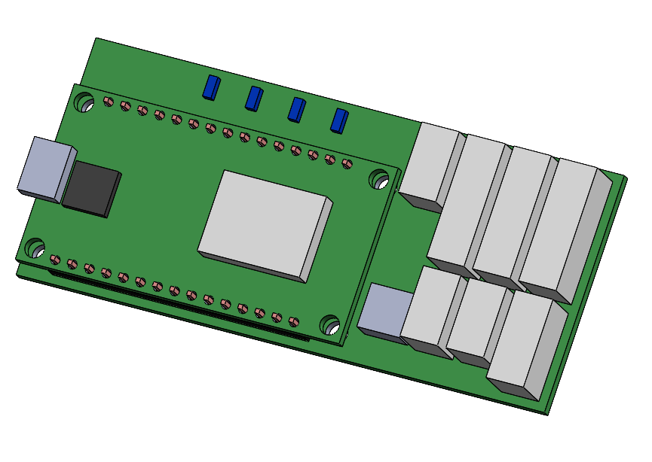
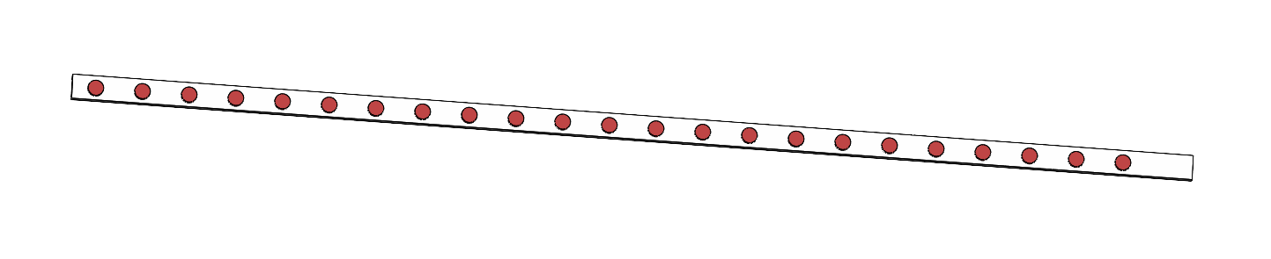
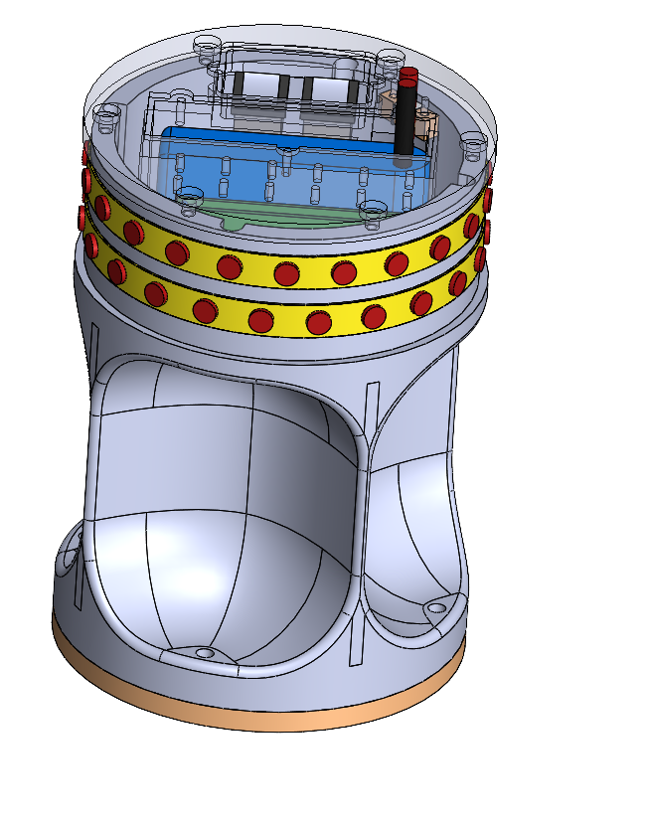
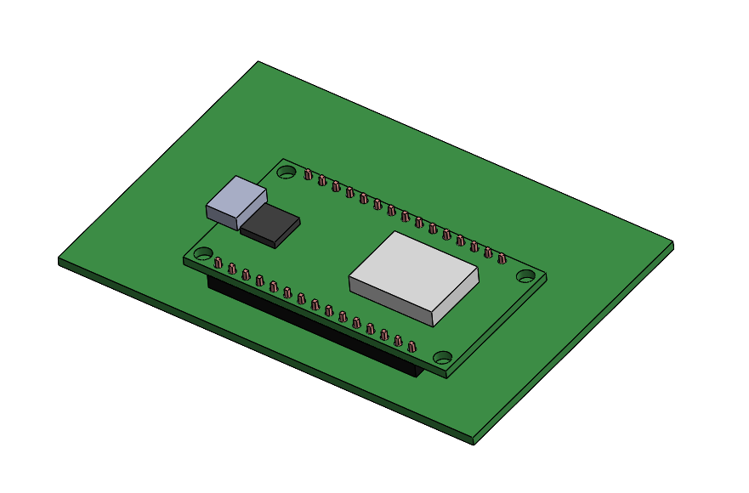
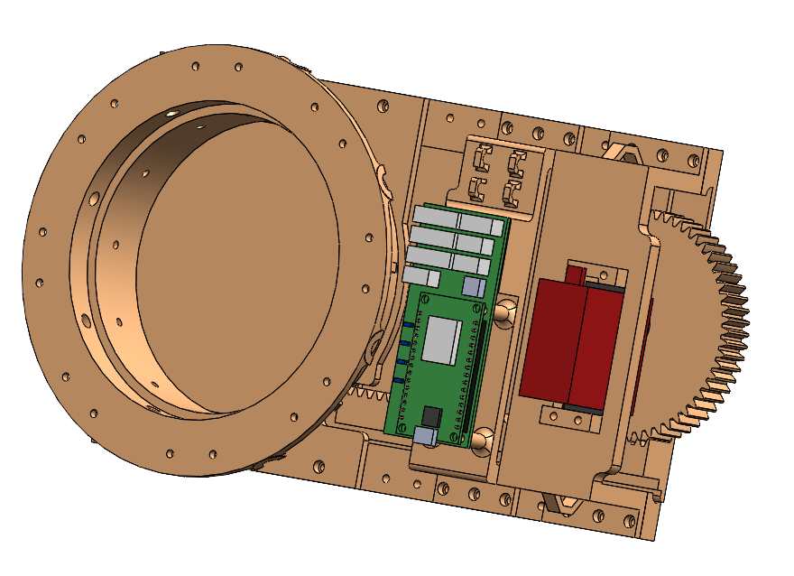
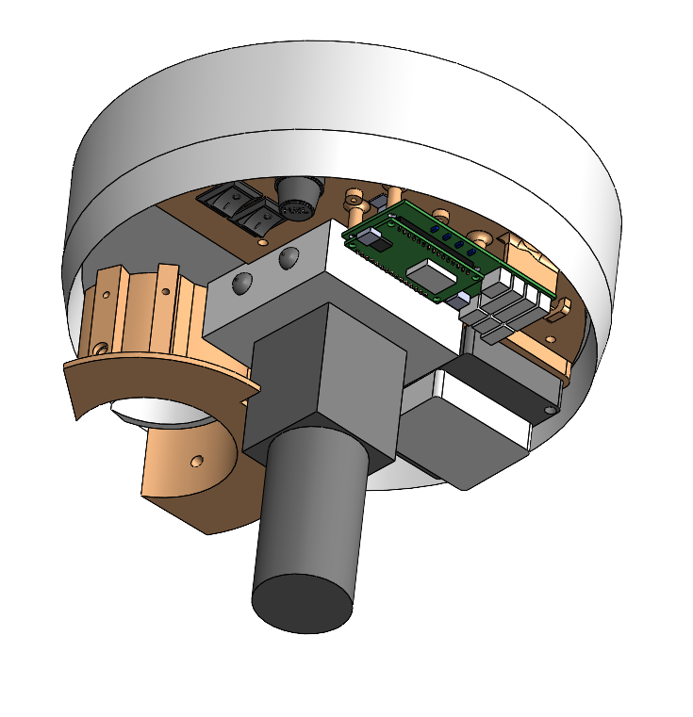
Overview of Electronics for Field Elements
Target Board Display Unit
Not implemented you, but planned
For control of Neo LEDs on Target
Board.
Two versions (V1, V2) of a PCB were manufactured to support EpicFMS.
The schematics for these PCBs are named “Moving Target Unit, V4” and
“Moving Target Unit, V5”, respectively.
These feature an ESP8266 for WiFi.
Target Board
The Target Boards features 3 targets
that can open and close on command from the EpicFMS server. In addition,
there is a plan for a strip of NEO LEDs at the stop, also controlled by the server.
Sliding Target Unit
Each of these uses a V2 PCB, and
is wired according to the
“Sliding Target Wiring Schematic”
Power 7-9 volts DC @ 5 amps, either from 2S Lipo, or AC wall wart.
Moving Target Unit
These units use V2 of the PCB,
And are wired according to
“Moving Target Wiring Schematic”
Power to this unit is an internal
2S Lipo battery.
Basket Target Unit
These units use V2 of the PCB,
And are wired according to
“Basket Wiring Schematic”
Power to this unit is 12 volts
DC @ 5 amps, either from a
3S Lipo Battery, or an AC Wall Wart.
= WiFi Enabled Device

Slide 4
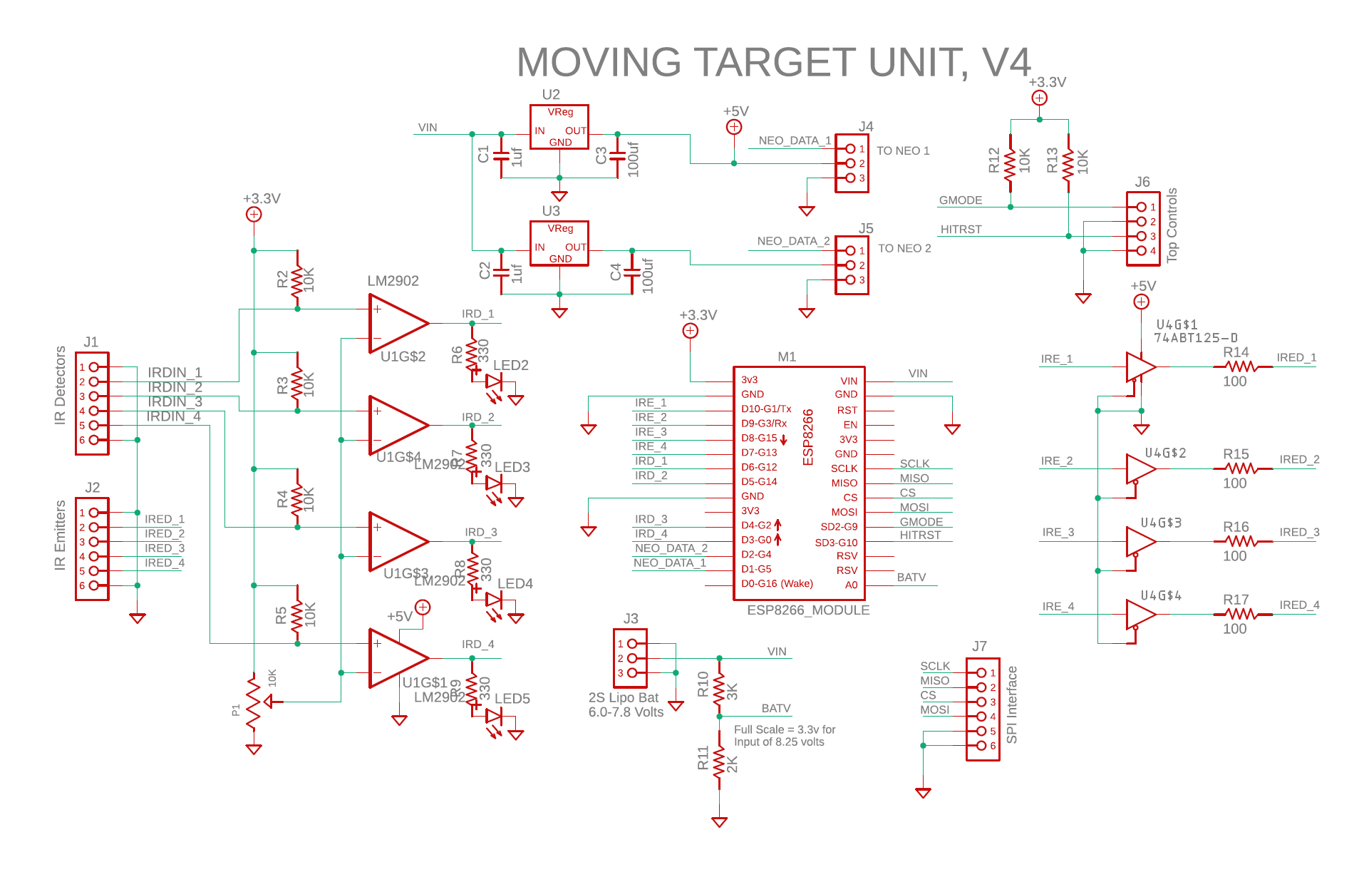
PCB Schematic, V1
V1 of the PCB was manufactured
from this schematic.
None of these PCBs were
used in the final game
implementation.

Slide 5
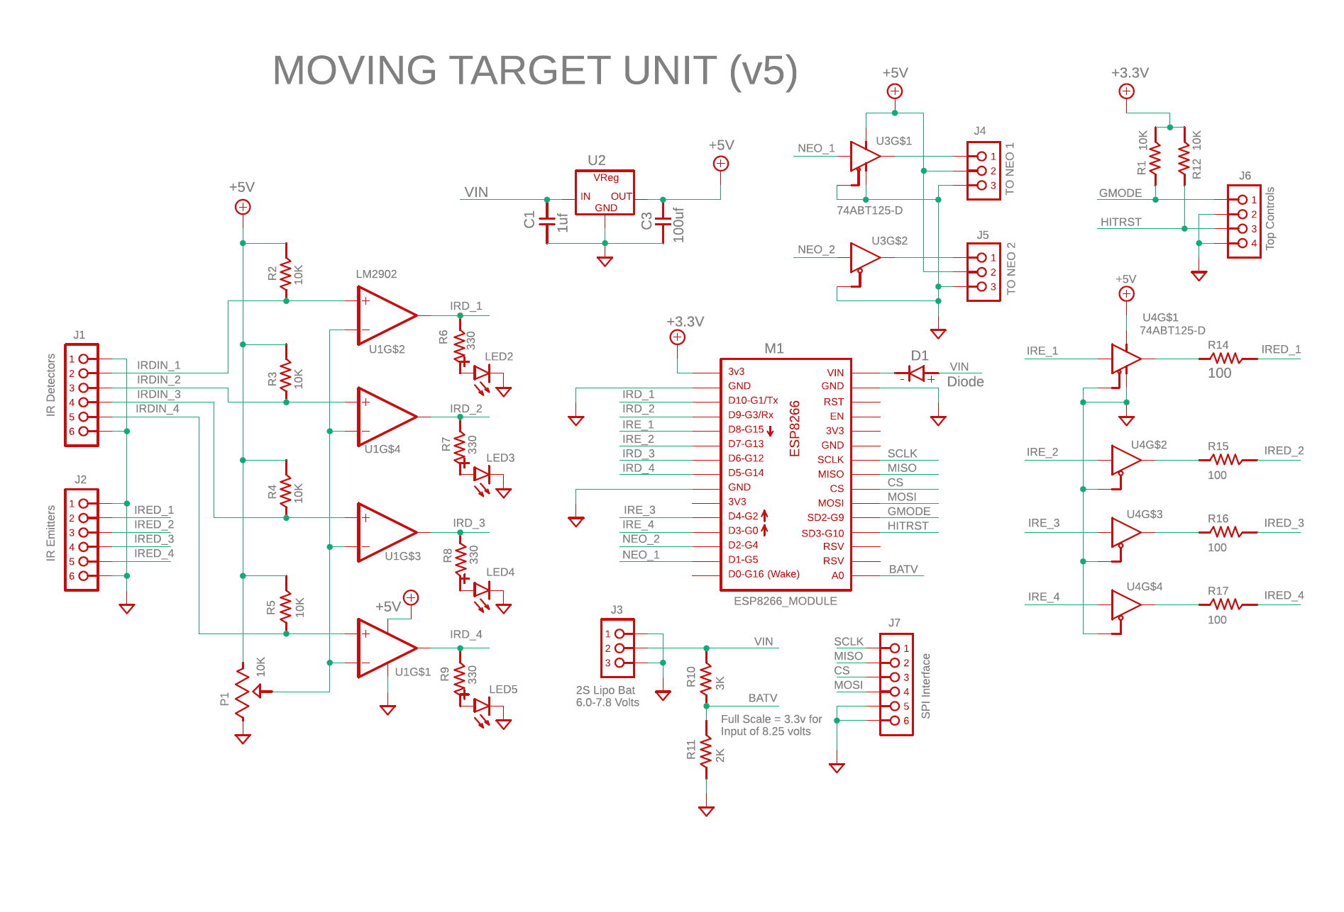
PCB Schematic, V2
V2 of the PCB was manufactured
from this schematic.
After V2 was made,
It was discovered that
D9, D10, and SD2 are
Not to be used. Therefore
Traces were cut to D9 and D10, and
IRD_1 and IRD_2 were routed to ??

Slide 6
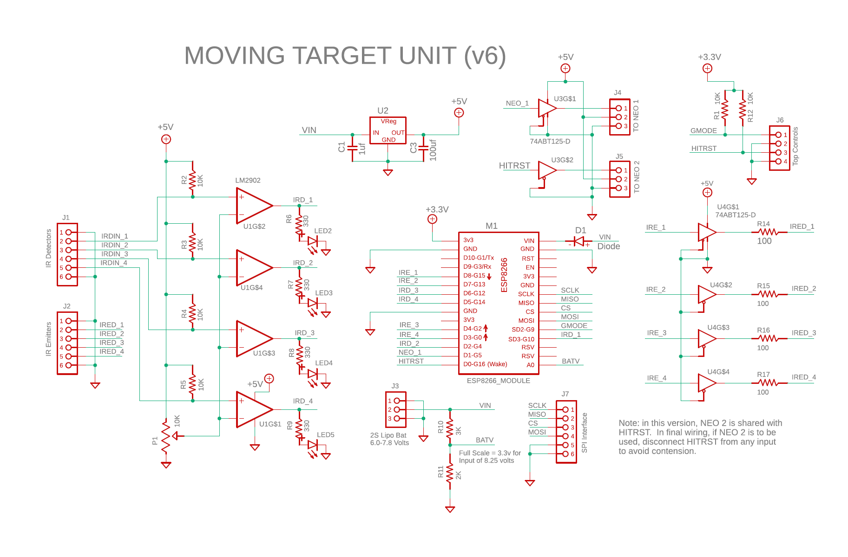
PCB Schematic, V3
The V2 PCBs were modified
to be this circuit. V3 is the
version used in the
Slider units.

Slide 7
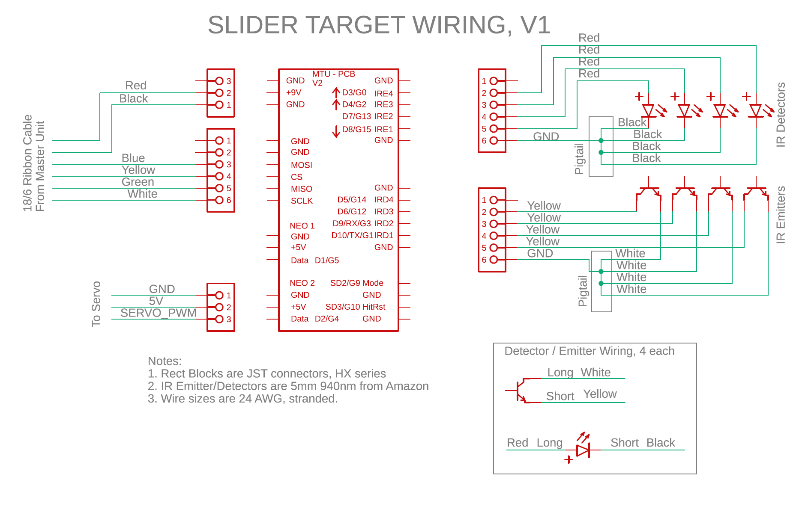
Sliding Target Wiring Schematic

Slide 8
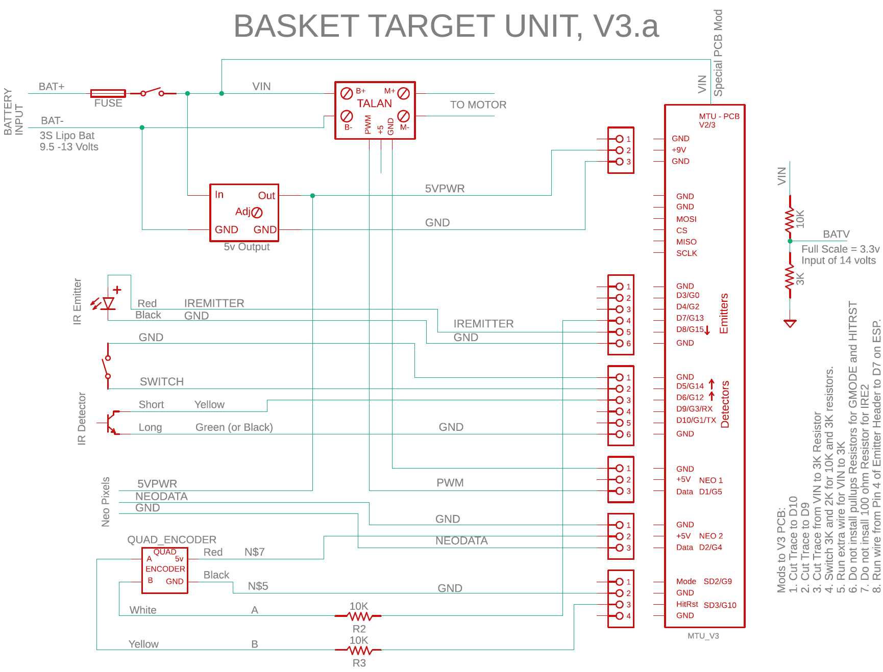
Basket Target Wiring, Version Based on V2/3 of PCB
Coming Soon, I Hope.

Slide 9
KNOWN Issues with the EPS8266
What as been learned through experimenting and study:
1. DO NOT USE the "D" numbers such as D0, D1, etc when specifying pins.
2. Pins seem to always be specified with the G numbers.
3. If you want a serial port to upload code and debug,
DO NOT USE D9 and D10 for any circuitry.
4. D0/G16 is connected to the on-board LED.
5. D0/G16 cannot be used for PWM or Interrupts!
6. D0/G16 cannot be used for NEO pixels!
7. D0/G16 can be used to turn on/off a simple LED
8. D1, D2, D3, D4, D5, D6, D7, D8, and SD3 all work with interrupts.
9. Startup problems and upload problems are likely if you use D0.
10. On some boards, using SD2 causes the hardware WDT to trigger,
so it cannot be used either.
11. On boot, MANY GPIO are asserted high: D0/G16, D9/G3/RX,
SD3/G10, SD2/G9, D4/G2, D10/G1/TX. If any of these pins are
forced low at boot time, there will be problems.
12. Also, on boot, D8 most NOT be pulled HIGH. D8 has a pulldown
resister to hold it low at boot.

Slide 10
MOVEING TARGET CIRCUIT BOARD CONNECTORS
Gnd
Gnd
Gnd
Gnd
+7-9v
Gnd
E4
D4
Battery In
Gnd
MOSI
E3
D3
SPI
IR Emitters
IR Detectors
CS
E2
D2
MISO
E1
D1
SCLK
Gnd
Gnd
USB
ESP8266 Module
Mode
Switches
+5v
+5v
Gnd
Neo Pixels 1
Neo Pixels 2
Data
Data
HRst
Gnd

Slide 11
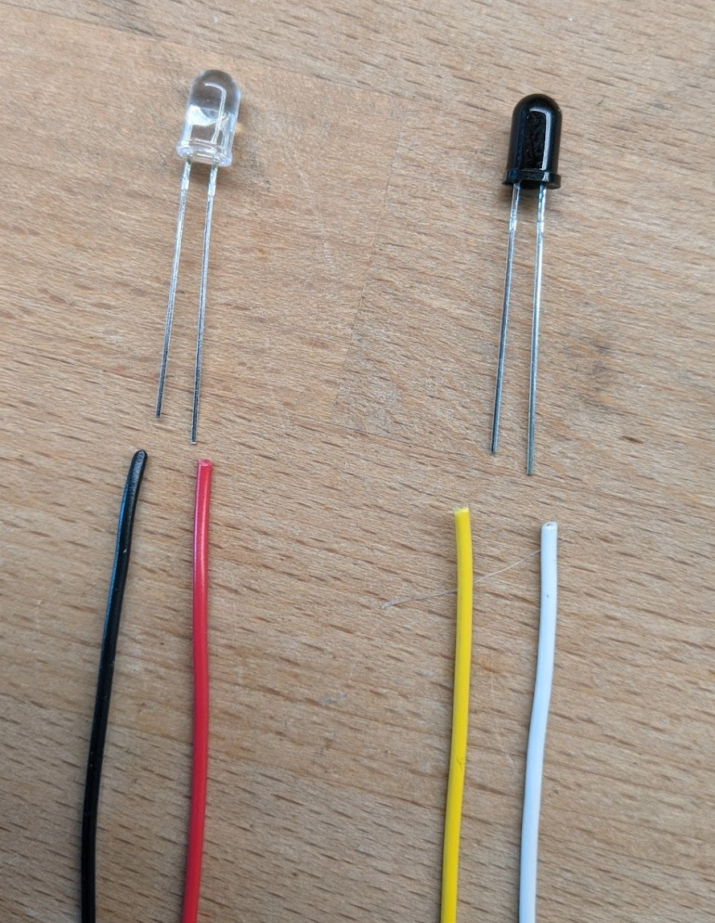
Wiring IR Emitter/Detectors
The CLEAR LED is the Emitter.
Our circuit sends about 17ma of current through this device.
The RED wire carries positive voltage and must be connected to the LONG lead.
The BLACK wire should be connected to the SHORT lead.
Use 24-26 AWG stranded wire.
The Dark Component is the Detector.
When it detects IR light, it allows
current to flow between it’s leads, but
in only one direction: from the short lead
to the long lead.
The YELLOW wire is the positive side and
Must be connected to the SHORT lead.
The WHITE wire is the negative side and
Must be connected to the LONG lead.

Slide 12
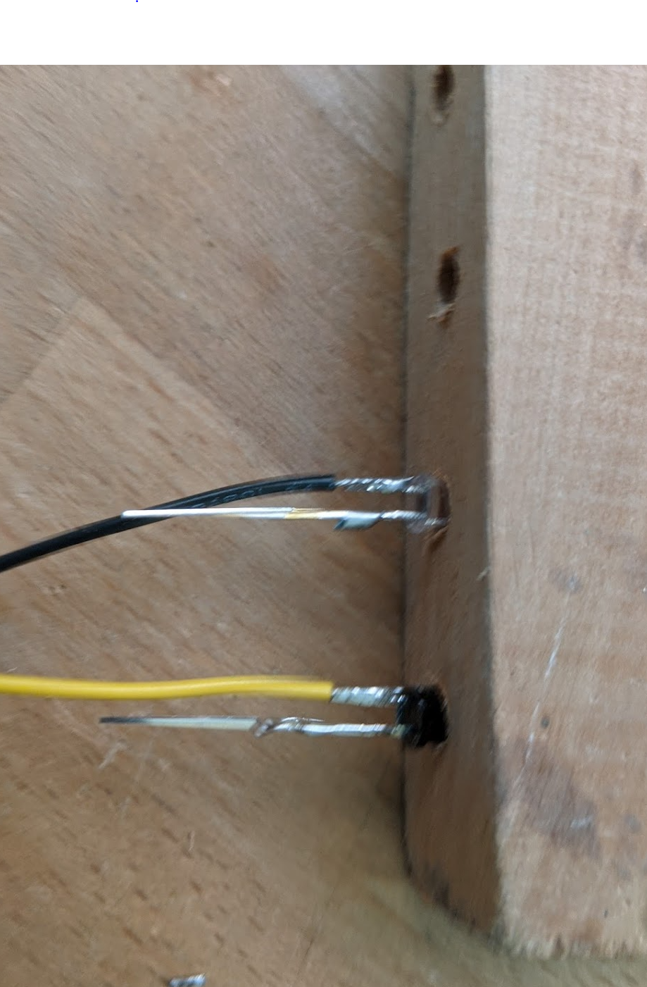
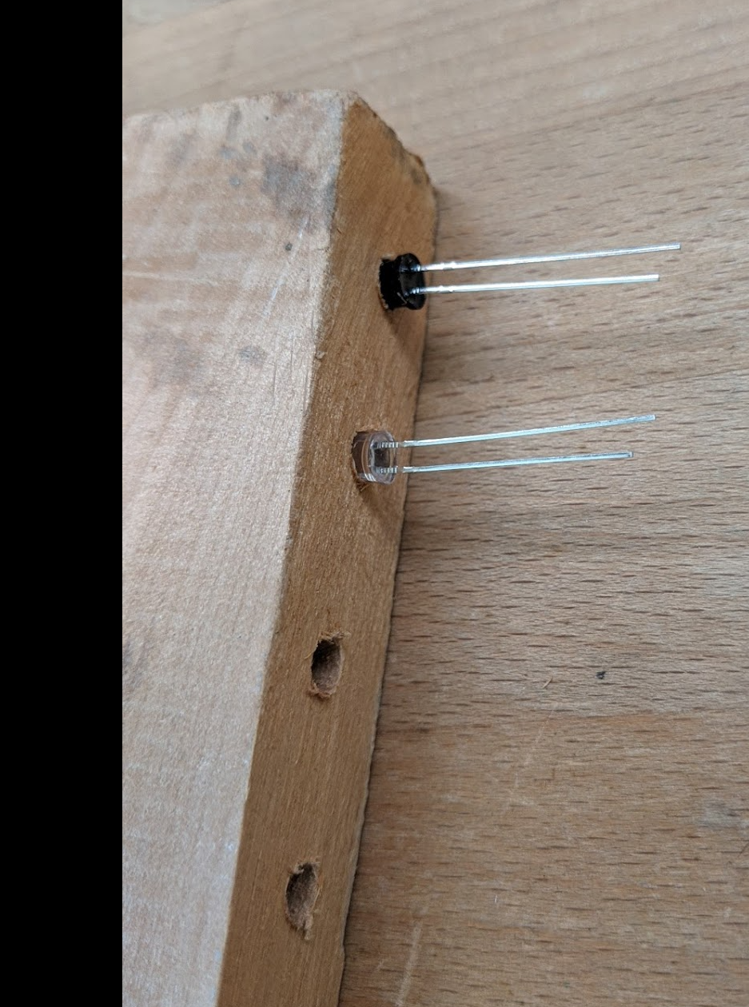
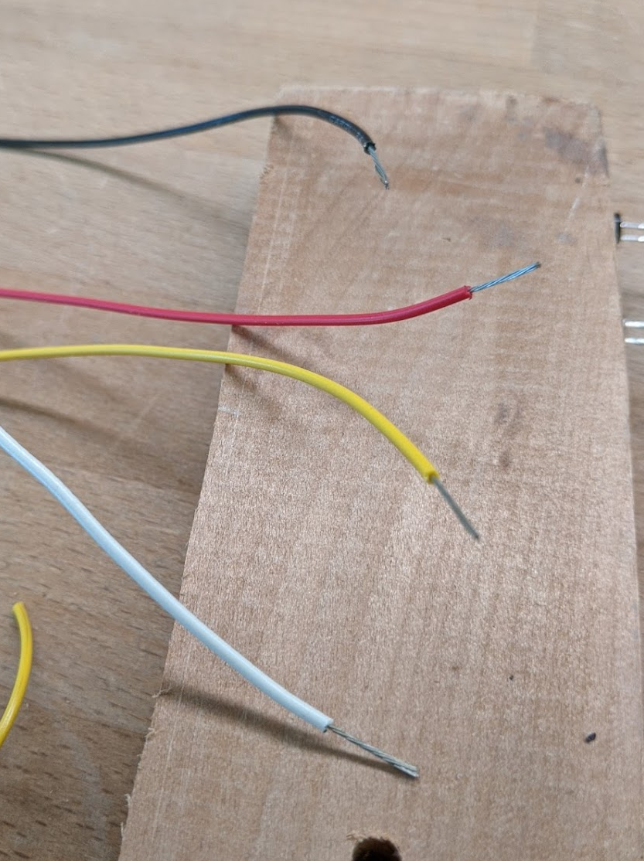
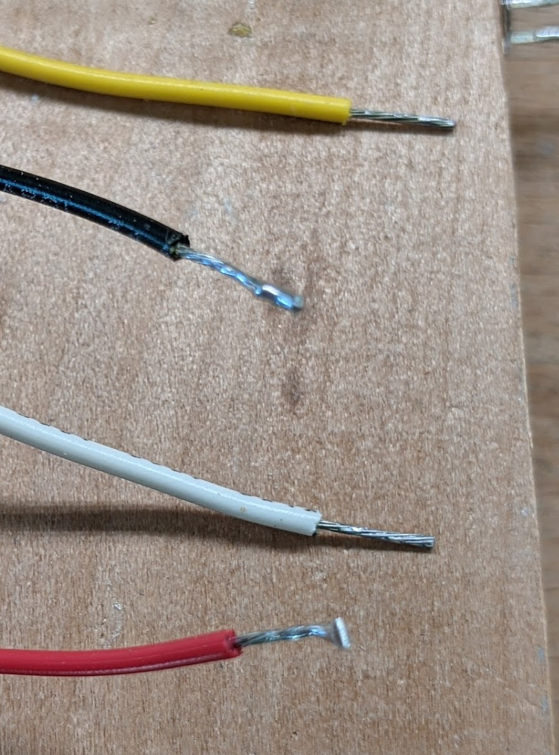
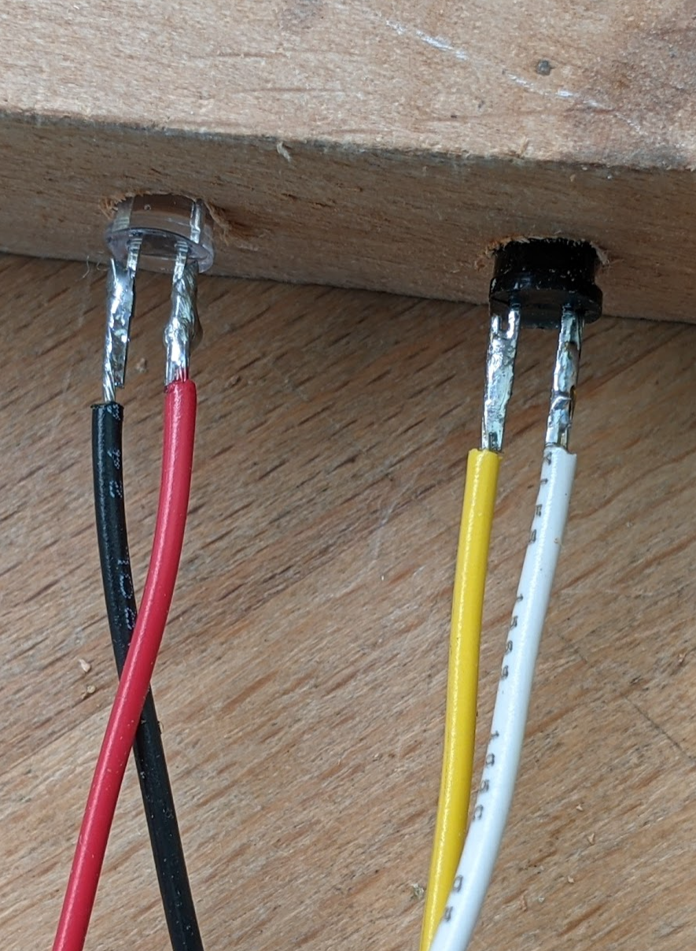
Steps to Solder Wires to the IR Components
Start with the components in the soldering jig with the long leads nearer the top of the jig.
Strip about 0.5 inch of insulation from each wire.
Tin all wires and leads. Then trim the wires so that there is about 3/8 inch of conductor showing.
Cut the short leads to about 3/8 inch. And then use the parallel solder technique to solder the wires.
Do the same for the long leads.
Parallel solder technique: After tinning both wire and lead, bring the wire along side of the lead (i.e., parallel to it), and then heat both with the soldering iron at the same time. Allow the solder to flow between the lead and the wire while holding the wire very steady. Remove the soldering iron while keeping the wire absolutely still until the solder cools.

Slide 13
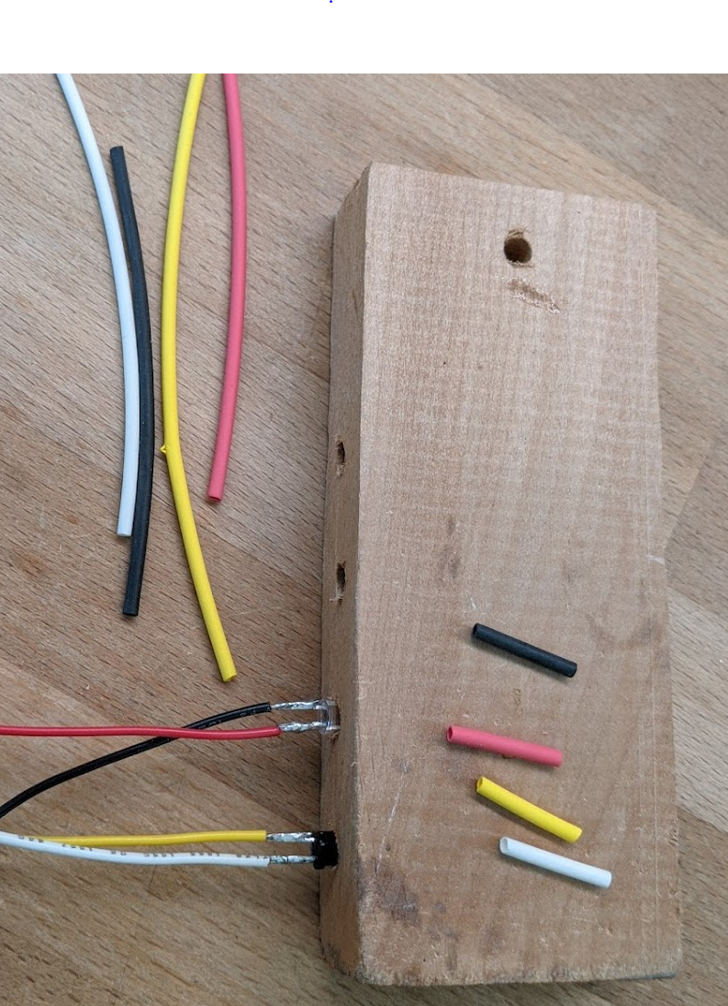
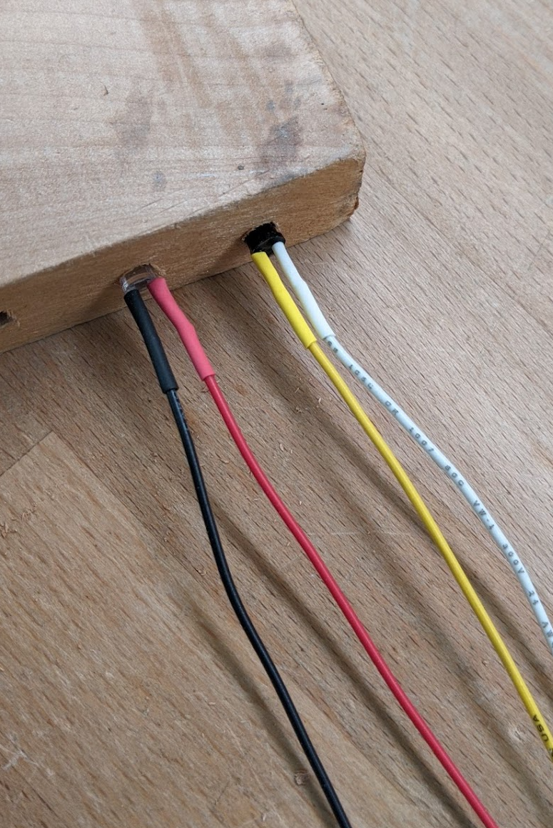
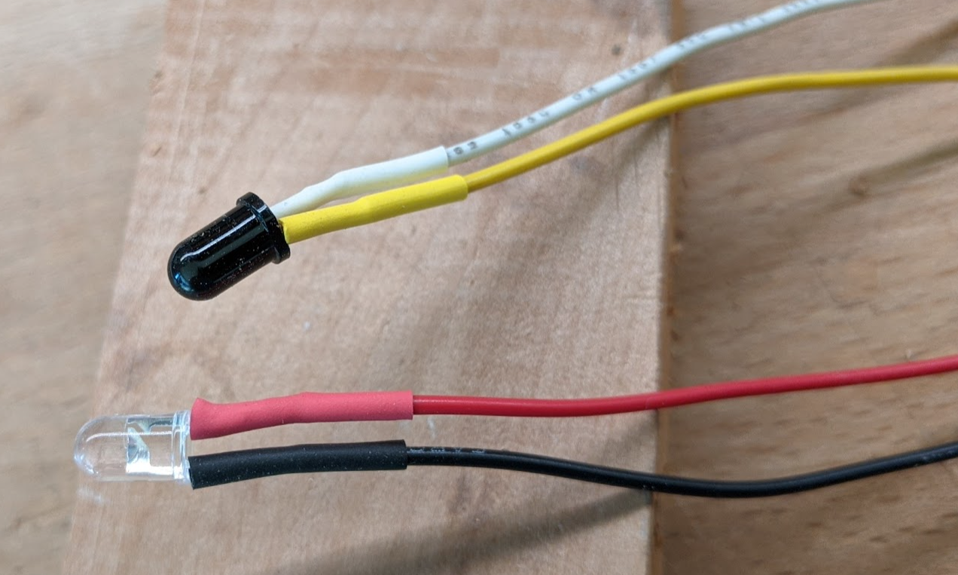
Steps to Finish the Soldered IR Components
Cut about 5/8” of heat shrink tubing for each wire. Try to use the same color. Use 1/16 “ diameter tubing (measured before heat applied).
Slide the heat shrink tubing on each wire all the way to the component. Apply heat with a heat gun. Don’t use a match!
All Done!

Slide 14
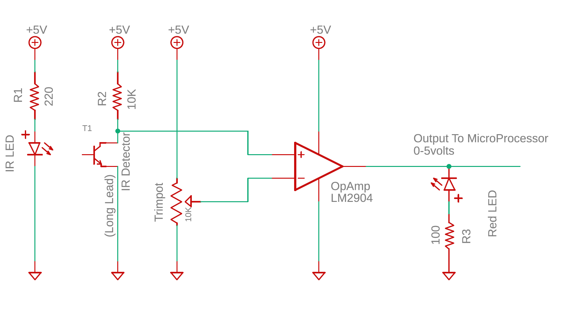
IR Emitter / Detector Test Circuit
Notes:
The IR Emitter, as shown with a 220 ohm resistor draws about 17 mA.
The voltage at the + terminal on the OpAmp runs between 0.12 volts when the beam is detected, and 3.5 volts when the beam is broken.
The OpAmp is wired as a simple comparator. It outputs a hard 0 volts if the beam is detected, and about 3.5 volts if the beam is broken.
The Red LED after the OpAmp is included to indicate when the beam is broken.

Slide 15
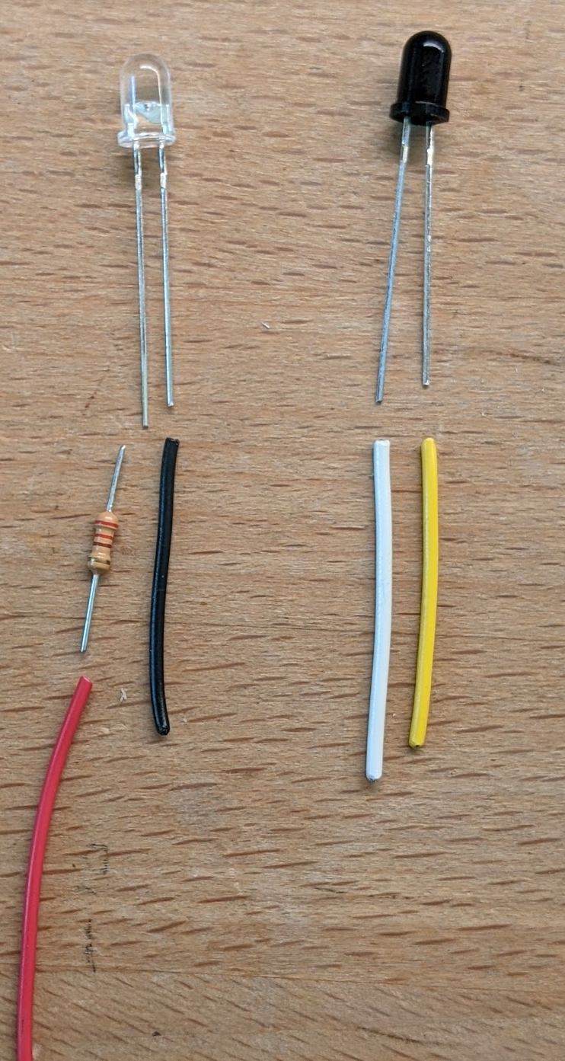
IR Emitter / Detector Wiring
OBSOLETE!! Design Changed.
The Clear LED is the Emitter.
Connect a Red wire to a 220 ohm resister and then to the long lead. On the short lead, connect a black wire.
Use 24-26 AWG stranded wire.
When powered with 5 volts,
Each emitter will draw about 14 mA.
The Dark Blub Component is the Detector.
Connect a white wire to the long lead. Connect a yellow wire to the short lead.
Use 24-26 AWG stranded wire.
In the circuit, the white lead will be connected to ground. When the detector is “on”, current will flow from the yellow wire though the detector to ground.

Slide 16
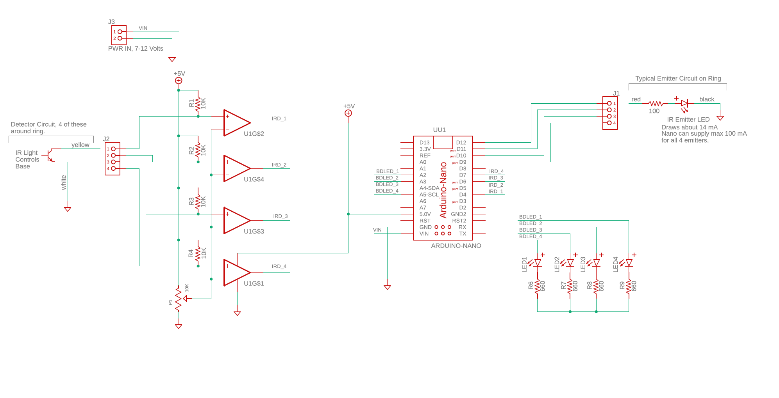
Ring Detection Circuit, Version 1
This circuit was used in early development to test IR detection. It is
not part of the final system.

Slide 17
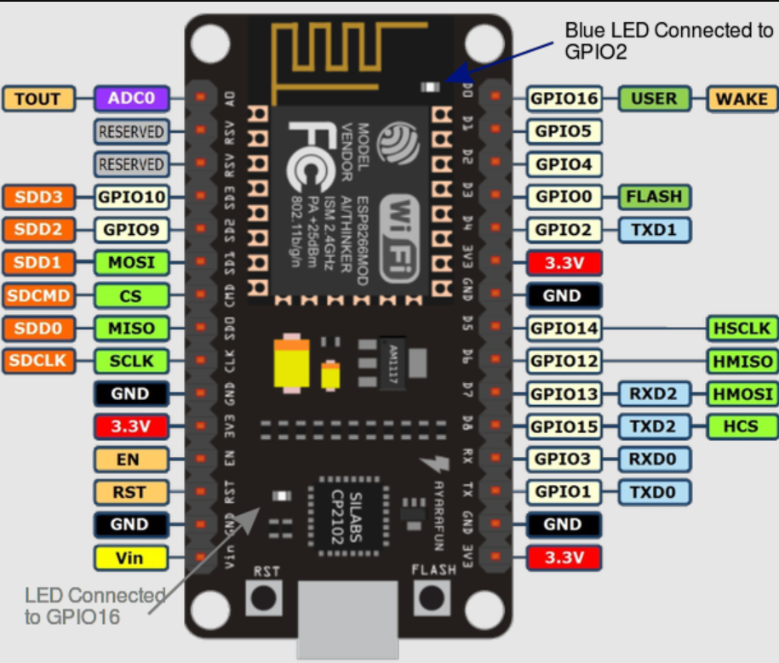
Pinout for nodeMCU

Slide 18
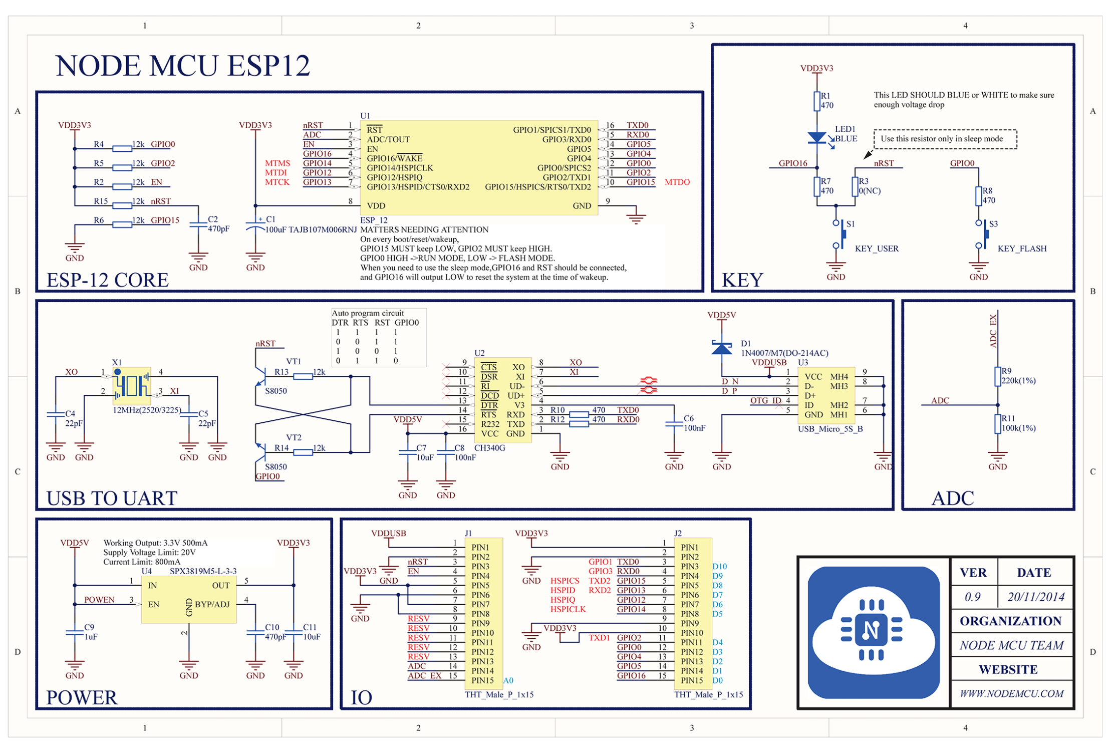

Slide 19
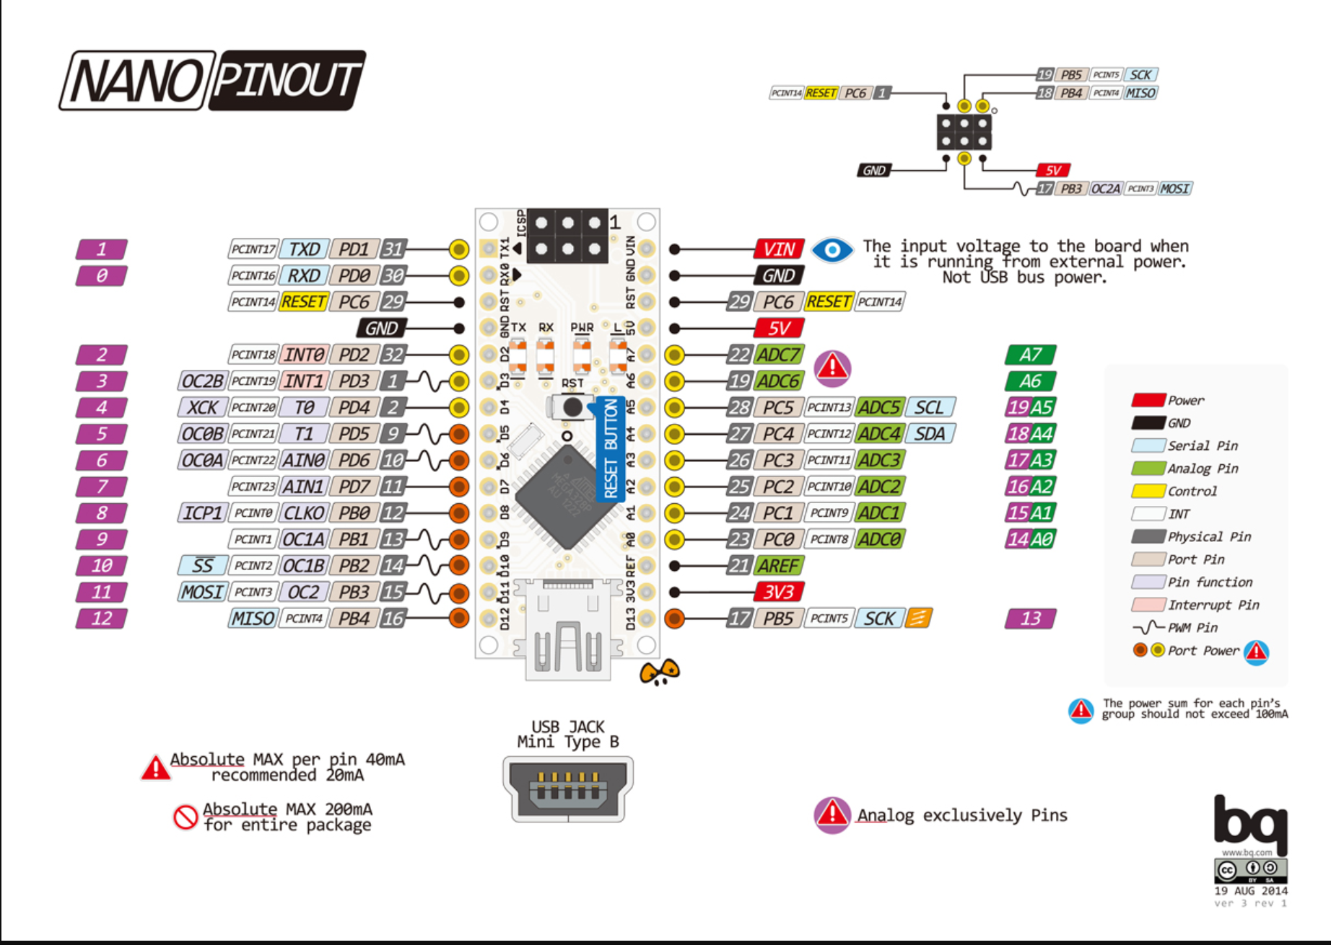
INFO About Arduino NANO – Pin Mappings

